Slide 1
Why Usain Bolt is the GOAT of all GOATS
Brandon Wisniewski, Abhi Joshi, Pat Walther, Connor Stephens, & Robbie Goss

Slide 2
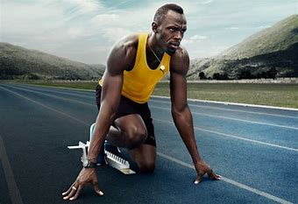
Background
Born Usain St. Leo Bolt in Sherwood Content, Jamaica on August 21, 1986
Measurables: 6’5” 207 lbs.
Right leg ½ inch shorter than left leg
First loved the sport of cricket as a kid
Gained notoriety at 2002 World Junior Championships in home country
Idolizes Don Quarrie
8 Olympic gold medals, 11 World Championship gold medals
Notes:
Was awarded the Order of Jamaica (their equivalent of British Knighthood) so his real title is “the honorable”
He was only 15 when he won his 2002 world junior championship gold medal (youngest world junior gold medalist ever)
(Don Quarrie) A 1976 olympic gold medalist from Jamaica and best times were 10.07 in the 100 and then 19.86 in the 200

Slide 3
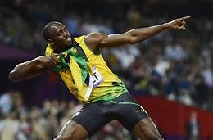
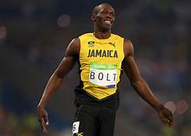
Bolt’s Unprecedented Dominance
Bolt’s 6’5” height was previously believed to be detrimental to sprinting
Bolt runs asymmetrically, as his left leg spends 14% more time on the ground than his right, while producing 13% less peak force
While defying previously believed notions about sprinters, Bolt
Ran 7 of the 15 fastest 100m times ever recorded, including the 3 fastest (3 way tie for third fastest at 9.69)
Ran 4 of the 6 fastest 200m times ever recorded, including the fastest
Won 11 world championships
Won 8 olympic gold medals

Slide 4
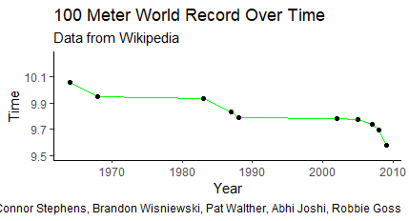
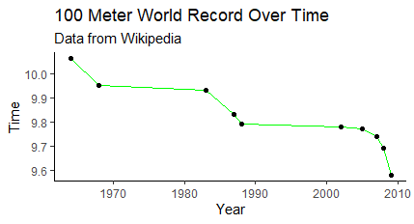
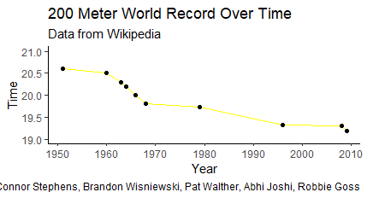
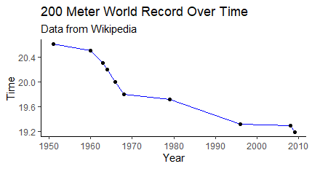
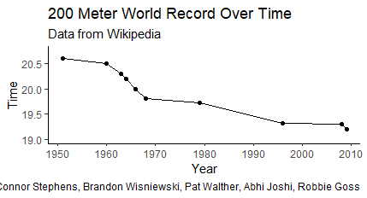
Bolt’s Dominance
Bolt
Bolt
Bolt
Bolt
Bolt
Notes:
9.58, 19.19

Slide 5
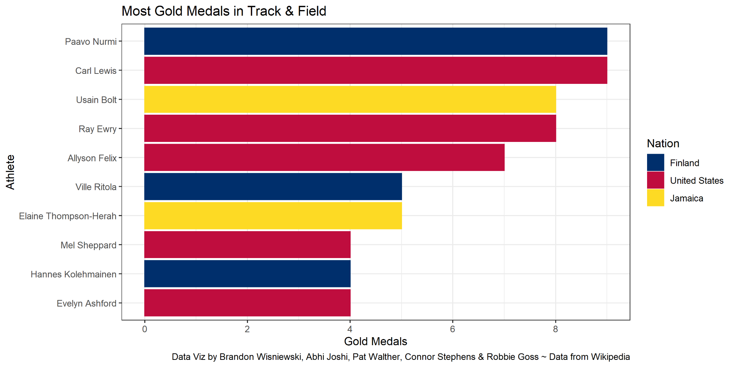
Comparison to other Track & Field Athletes
*Would’ve had 9 Gold Medals if he didn’t get stripped a Gold Medal in the 2008 Olympic 4x100m Relay due to a teammate testing positive for doping.

Slide 6
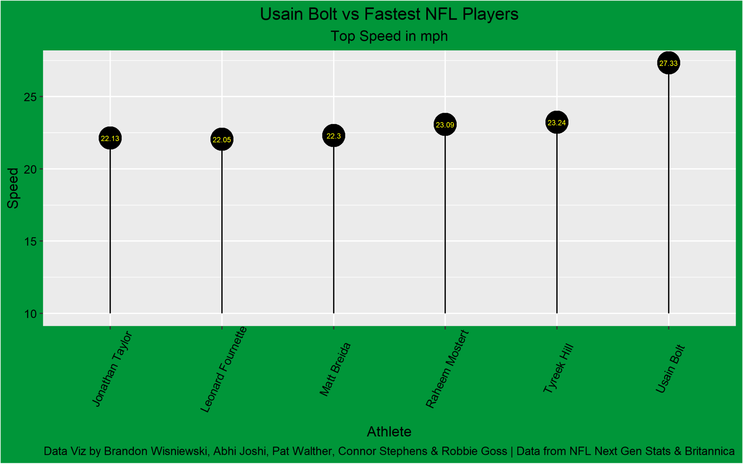
How would Bolt do in other sports?

Slide 7
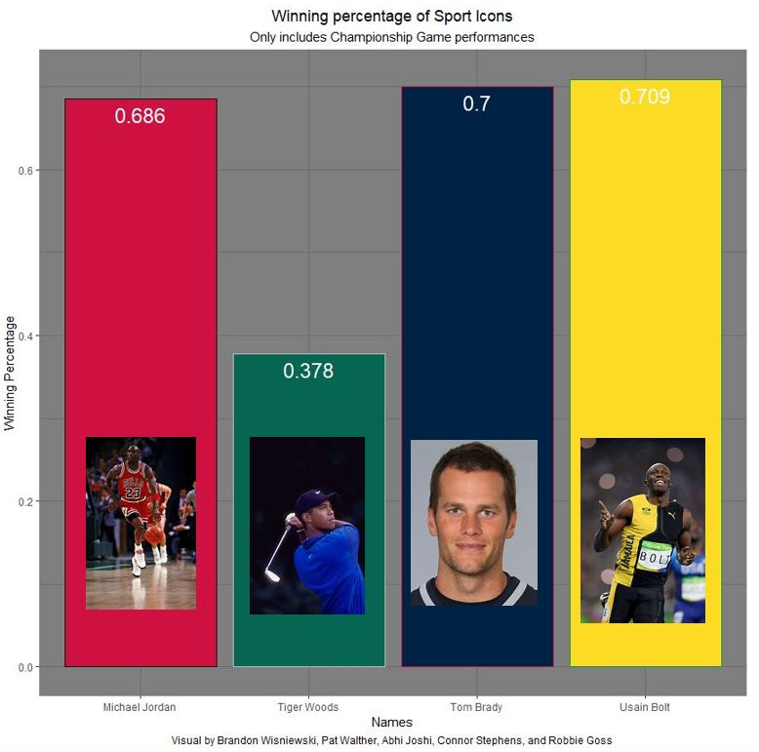
How does Bolt stack up with GOATs in other sports?

Slide 8
Sources
“Ngs: NFL next Gen Stats.” Next Gen Stats, https://nextgenstats.nfl.com/stats/top-plays/fastest-ball-carriers/2021/REG/all.
“How Fast Is the World's Fastest Human?” Encyclopædia Britannica, Encyclopædia Britannica, Inc., https://www.britannica.com/story/how-fast-is-the-worlds-fastest-human#:~:text=In%202011%20Belgian%20scientists%20used,(27.33%20miles%20per%20hour).
“Usain Bolt.” Wikipedia, Wikimedia Foundation, 12 Jan. 2022, https://en.wikipedia.org/wiki/Usain_Bolt.
“How Fast Is the World's Fastest Human?” Encyclopædia Britannica, Encyclopædia Britannica, Inc., https://www.britannica.com/story/how-fast-is-the-worlds-fastest-human#:~:text=In%202011%20Belgian%20scientists%20used,(27.33%20miles%20per%20hour).
“100 Metres.” Wikipedia, Wikimedia Foundation, 25 Jan. 2022, https://en.wikipedia.org/wiki/100_metres.
“Track and Field Best All-Time Performances.” Alltime, http://www.alltime-athletics.com/.
“Men's 200 Metres World Record Progression.” Wikipedia, Wikimedia Foundation, 20 Sept. 2021, https://en.wikipedia.org/wiki/Men%27s_200_metres_world_record_progression.
“Men's 100 Metres World Record Progression.” Wikipedia, Wikimedia Foundation, 31 Jan. 2022, https://en.wikipedia.org/wiki/Men%27s_100_metres_world_record_progression.
“Usain Bolt.” Wikipedia, Wikimedia Foundation, 12 Jan. 2022, https://en.wikipedia.org/wiki/Usain_Bolt.
Kiger, Patrick J. “Scientists Discover Something Mind-Blowing about How Usain Bolt Runs.” HowStuffWorks, HowStuffWorks, 2 Aug. 2017, https://health.howstuffworks.com/human-body/parts/uain-bolt-legs-asymmetrical-uneven-stride.htm.
Culture Trip. “Incredible Things You Didn't Know about Usain Bolt.” Culture Trip, The Culture Trip, 4 Dec. 2016, https://theculturetrip.com/caribbean/jamaica/articles/incredible-things-you-didnt-know-about-usain-bolt/.

